Slide 1
Data Preprocessing ——Data Cleaning——
徐华
清华大学 计算机系 智能技术与系统国家重点实验室
xuhua@tsinghua.edu.cn

Slide 2
Data Preprocessing
About data
Why preprocess the data?
Descriptive data summarization
Data cleaning
Data integration and transformation
Data reduction
Discretization and concept hierarchy generation
Summary

Slide 3
Data Cleaning
Importance
“Data cleaning is one of the three biggest problems in data warehousing”—Ralph Kimball
“Data cleaning is the number one（No.1） problem in data warehousing”—DCI survey
Data cleaning tasks
Fill in missing values
Identify outliers and smooth out noisy data
Correct inconsistent data
Resolve redundancy caused by data integration

Slide 4
Missing Data
Data is not always available
E.g., many tuples have no recorded value for several attributes, such as customer income in sales data
Missing data may be due to
equipment malfunction
inconsistent with other recorded data and thus deleted
data not entered due to misunderstanding
not register certain data may not be considered important at the time of entry
history or changes of the data
Missing data may need to be inferred.

Slide 5
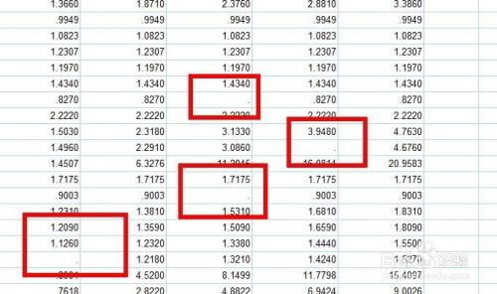
How to Handle Missing Data?
Ignore the tuple: usually done when class label is missing (assuming the tasks in classification—not effective when the percentage of missing values per attribute varies considerably.
Fill in the missing value manually: tedious(冗余) + infeasible?
Fill in it automatically with
a global constant : e.g., “unknown”, a new class?!
the attribute mean
the attribute mean for all samples belonging to the same class: smarter
the most probable value: inference-based such as Bayesian formula or decision tree

Slide 6
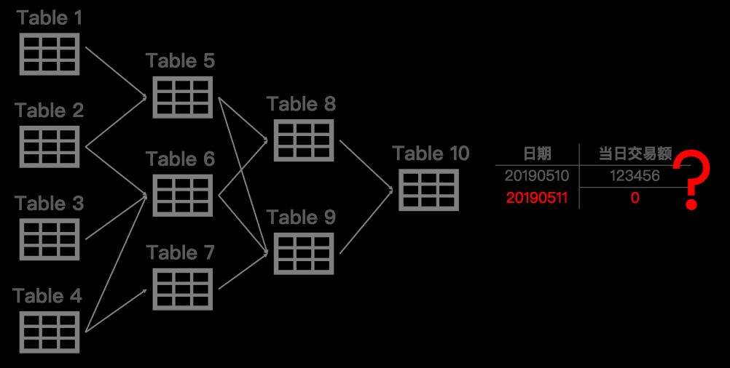
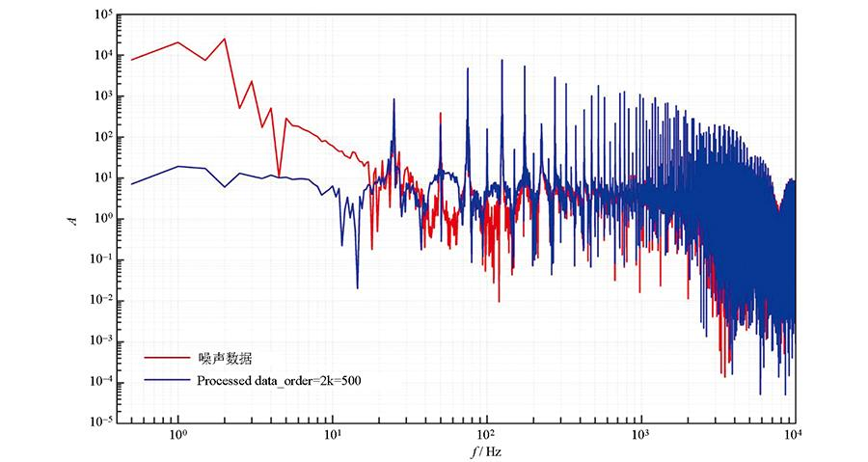
Noisy Data
Noise: random error or variance in a measured variable
Incorrect attribute values may due to
faulty data collection instruments
data entry problems
data transmission problems
technology limitation
inconsistency in naming convention（命名约定）
Other data problems which requires data cleaning
duplicate records
incomplete data
inconsistent data

Slide 7
How to handle noisy data?
Binning（分箱）
first sort data and partition into (equal-frequency) bins
then one can smooth by bin means, smooth by bin median, smooth by bin boundaries, etc.
Clustering
detect and remove outliers
Combined computer and human inspection
detect suspicious values and check by human (e.g., deal with possible outliers)
Regression
smooth by fitting the data into regression functions

Slide 8
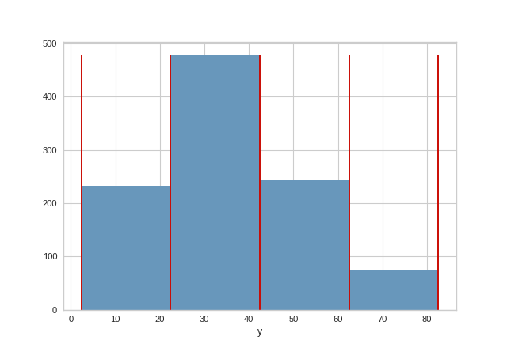
Simple Discretization Methods: Binning
Equal-width (distance) partitioning:
Divides the range into N intervals of equal size: uniform grid
if A and B are the lowest and highest values of the attribute, the width of intervals will be: W = (B –A)/N.
The most straightforward, but outliers may dominate presentation
Skewed data is not handled well.
Equal-depth (frequency) partitioning:
Divides the range into N intervals, each containing approximately same number of samples
Good data scaling
Managing categorical attributes can be tricky.

Slide 9
Binning Methods for Data Smoothing
Sorted data for price (in dollars): 4, 8, 9, 15, 21, 21, 24, 25, 26, 28, 29, 34
Partition into equal-frequency (equal-depth) bins:
Bin 1: 4, 8, 9, 15
Bin 2: 21, 21, 24, 25
Bin 3: 26, 28, 29, 34
Smoothing by bin means:
Bin 1: 9, 9, 9, 9
Bin 2: 23, 23, 23, 23
Bin 3: 29, 29, 29, 29
Smoothing by bin boundaries:
Bin 1: 4, 4, 4, 15
Bin 2: 21, 21, 25, 25
Bin 3: 26, 26, 26, 34

Slide 10
Regression
y
Y2
Y1’
y = x + 1
X1
x

Slide 11
Cluster Analysis

Slide 12
Data Cleaning as a Process
Data discrepancy (不符/异常) detection
Use metadata (e.g., domain, range, dependency, distribution)
Check field overloading
Check uniqueness rule, consecutive rule and null rule
Use commercial tools
Data scrubbing(数据清洗): use simple domain knowledge (e.g., postal code, spell-check) to detect errors and make corrections
Data auditing(数据审查): by analyzing data to discover rules and relationship to detect violators (e.g., correlation and clustering to find outliers)
Data migration and integration
Data migration tools: allow transformations to be specified
ETL (Extraction/Transformation/Loading) tools: allow users to specify transformations through a graphical user interface
Integration of the two processes
Iterative and interactive (迭代和互动 e.g., Potter’s Wheels)

Slide 13
Thanks！
Notes:
工作新意图发现

